Slide 1
Solutions and Potential for Climate Action in
Indian Cities
22 September 2015
New Delhi
Emani Kumar,
ICLEI Deputy Secretary General and Regional Director-ICLEI South Asia Secreteriat

Slide 2
Introducing ICLEI-Local Governments for Sustainability (ICLEI)
An international city network established in 1990 that advances local sustainability.
ICLEI’s mission is “to build and serve a worldwide movement of local governments to achieve tangible improvements in global sustainability with special focus on environmental conditions through cumulative local actions.”
1000+ members in 86 countries, representing 660 million people in mega-cities, super-cities, urban regions, large cities, small and medium-sized cities & towns. Also States / Provinces as members.
Main activities:
  (i) Support our members with technical expertise, tools, guidance.
  (ii) Facilitate city peer exchange, support networking.
  (iii) Operate global processes
  (iv) Conduct international advocacy and representation.

Slide 3
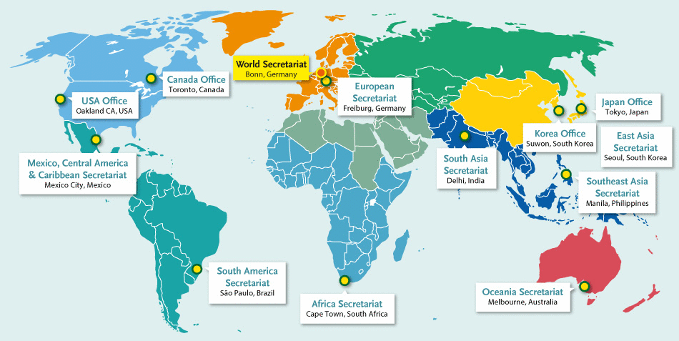
Offices around the world

Slide 4
ICLEI South Asia
The South Asian regional chapter of ICLEI Local Governments for Sustainability.
Working with South Asian cities with funding support from various national and international partners by offering opportunities:
  participation in programs and projects
  information services, training and conferences
South Asian Region
  India Pakistan
  Afghanistan Bangladesh
  Bhutan Sri Lanka
  Nepal Maldives

Slide 5
ICLEI South Asia Members – 66
INDIA (47)
Ahmedabad | Pune | Rajahmundry
Bhavnagar | Panaji | Rajkot
Bhopal | Ichalkaranji | Salem
Bhubaneshwar | Jabalpur | Shimla
Chandrapur | Jamnagar | Surat
Coimbatore | Kalyan Dombivli | Tenali
Dehradun | Kishangarh | Thane
North Delhi | Kolhapur | Tiruchirapally
Gangtok | Kolkata | Tirupati
Gandhinagar | Kota | Tiruppur
Guntur | Kurseong | Vadodara
Gurgaon | Madurai | Vijayawada
Guwahati | Mumbai | Vishakhapatnam
Gwalior | Mysore | Warangal
Howrah | Nashik | Tirunelveli
Hyderabad | Nagpur
BANGLADESH (4)
Rajshahi
Dhaka
Barisal
Singra
SRI LANKA (4)
Matale
Kandy
Kurunegala
Galle
BHUTAN (2)
Phuentsholing
Thimphu
MALDIVES (1)
Malé
NEPAL (4)
Kathmandu
Pokhara
Lalitpur
Hetauda
ASSOCIATE PARTNERS (4)
All India Institute of Local Self Government (AIILSG)
Punjab Municipal Infrastructure Development Company (PMIDC)
Municipal Association of Nepal (MuAN)
Local Government Authority , Maldives

Slide 6
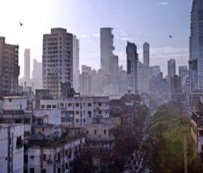
Key Urban Sectors for GHG emission reduction intervention
Roads & Transportation
Urban poor & Slums
Land use & Development
Buildings
Water Supply
Street lighting
Sewerage & Drainage
Solid Waste Management

Slide 7
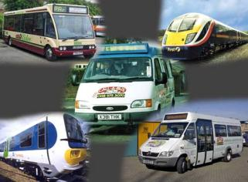
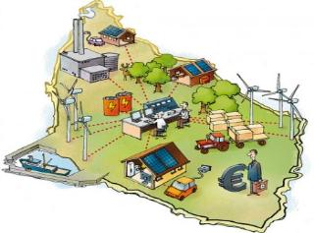
Solutions and Strategies across Sectors
Land Use & Development
Roads & Transportation
Bicycle Share (Rental)
Provision of Cycle Tracks
Intelligent Transport System (Multi-modal Integration)
Parking Policy
Pedestrian and non-motorized Zones
Eco cabs - Rickshaw Management
Prohibiting development in eco-sensitive zone
Building codes for vulnerable areas
Green building policy & incentives
Conserve and develop green spaces, parks
Conserve water bodies
Transport oriented development
High density, mixed use development
Cycle laws, policies and Plans
Car Sharing
Street Design Guidelines

Slide 8
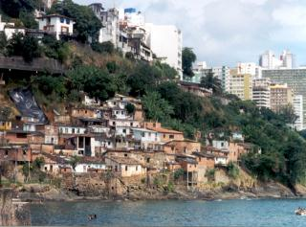
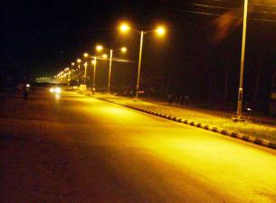
Solutions and Strategies across Sectors
Street Lighting
Buildings
Solar Water Heaters
Solar PV systems
Micro Wind PV hybrids
Landscape design for minimum water use
Low flow water faucets and taps
Wastewater treatment & reuse
Retrofit BEE star rated appliances
Passive Building design
Smart meters and controls
Energy Efficient Lighting
Optimum Street lighting Design
Replacement of Conventional Street lighting ballasts
Dimming & Auto ON/OFF Street lighting Controls
Intelligent Street lighting Control System
Voltage Controllers/ Regulators
Solar powered LED street lighting, blinkers & traffic systems
LED street lighting Retrofit
Urban Poor & Slums
Solar Water Heaters
Solar PV power packs
Community solar cookers
Clean cook stoves
Energy efficient lighting and appliances
LED street lighting
Decentralized waste water treatment systems
Community waste composting & biogas plants

Slide 9
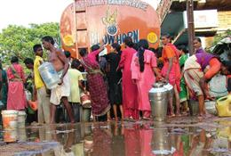
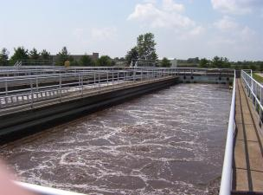
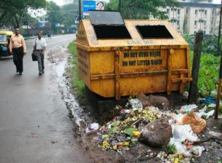
Solutions and Strategies across Sectors
Sewerage & Drainage
Septage treatment
Solid Waste
Water Supply
Incentives for waste segregation at source
Proper pump-system design
Power saver installation in pump house
Installation of variable speed drivers
Star rated pump sets and motors
Star rated transformers
Reduction of NRW
Augmentation of groundwater resources
Water reuse & recycling-industrial water supply
Integrated Water resource management
Anaerobic sludge digestion from wastewater
Decentralized wastewater treatment systems
Wastewater recycling and re-use
Energy efficient sewage pumping systems
Rejuvenation of water bodies
Recycling & waste minimization
Planning for waste transfer stations
Waste incineration with energy recovery
Bio-methanation
Composting of organic waste
Landfill CH₄ recovery
Public awareness

Slide 10
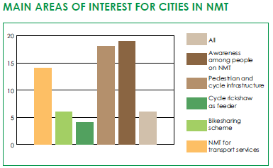
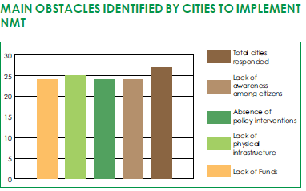
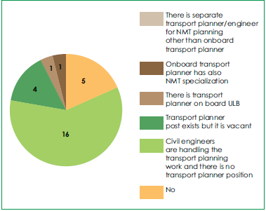
Public and Non-Motorized Transport (NMT) Systems
Shift to public transport- A city bus can carry 30 times more passengers, use half the energy and produce half the GHG emission compared to a car
Findings from assessments carried out in 28 cities for NMT
  Lack of specific policy and budgetary allocation for NMT
  Lack of trained transport planners/engineers in city governments
  NMT data not collected and updated regularly

Slide 11
Renewable Energy in Buildings
Every 100,000 Households with 100 LPD SWHS
Every 100,000 LPD SWHS in hospitals & hotels
125 million kWh/year
102,848 tonnes of CO₂e/yr
1.3 million kWh/year
1000 tonnes of CO₂e/yr
Solar Water Heating Systems (SWHS)
Energy saving: 1250-1500 kWh/year
Solar Photo-voltaic (SPV) Systems
Energy generation: 1400-1600 kWh/year
Cost ~INR 15,000
Rooftop area required :1.5 sq. metres
Cost of system~ INR 80,000- 100,000
Rooftop area required :10-12 sq. metres
For 100 liters per day capacity SWHS
For 1 kilowatt SPV system
Every 100,000 kW of SPV systems in buildings
150 million kWh/year
123,00 tonnes of CO₂e/yr
Reference: MNRE Solar Water Heater Market Assessment Report
Notes:
Hospitals have hot water requirement of 30-190 lpd per bed based on the type of hospital. Based on the class of hotels, benchmark hot water requirement varies from 30-150 lpd per room

Slide 12





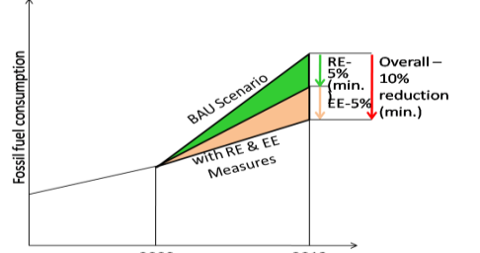
Solar Cities Programme
55 cities are now a part of the programme
Detailed Action Plan to be prepared targeting 10% reduction in energy baseline over 5 years through a combination of RE and EE measures
8 model cities - receive implementation support
15 pilot cities - receive partial implementation support
ICLEI South Asia assisting 15 Solar Cities
CHAMOLI GOPESHWAR
KOHIMA
GURGAON
AGRA
IMPHAL
RAJKOT
HOWRAH
AIZAWL
THANE
BHUBANESWAR
KALYAN DOMBIVLI
NAGPUR
MEHBUBNAGAR
COIMBATORE
COCHIN
5 year timeline

Slide 13
Renewable Energy Potential in Cities
Based on data for 10 Solar Cities

Slide 14
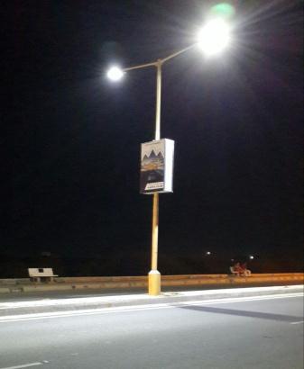
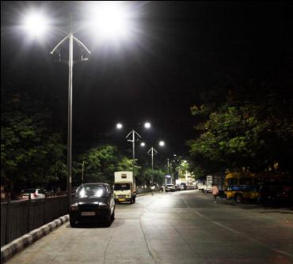
Energy Efficient Street Lighting
LED retrofit for 10,000 street lights through ESCO Model in Thane
Energy saving- 45,00,000 kWh/year
GHG emission reduction- 3,700,000 kg of CO₂e
LED retrofit for 522 street lights in slum areas of Thane
Energy saving- 277,000 kWh/year
GHG emission reduction- 228,000 kg of CO₂e
Improving infrastructure and LED retrofits for 6,500 street lights Panaji
Energy saving- 27,00,000 kWh/year
GHG emission reduction- 100,000 kg of CO₂e
LED street lights, Rajkot
LED retrofit for 290 street lights in Rajkot
Energy saving- 132,000 kWh/year ↓
GHG emission reduction- 100,000 kg of CO₂e
LED street lights, Thane
Data from pilot projects being implemented by ICLEI South Asia under the Urban Low Emission Development Strategies Project

Slide 15
Bio-methanation of Solid Waste
Bio-methanation plants generate energy in the form of biogas along with organic manure from organic waste
Organic waste such as vegetables, fruits, flowers and slaughter house waste can be segregated from households, government canteens, hotels, institutions, markets
Emission Reduction Potential for a 10 TPD bio-methanation plant
Amount of Food Waste | 10 tonnes per day
Area Required | 1200 sq. m.
Biogas Generated | 800 cu. m./day
Energy equivalent to | 760 LPG cylinders/month
Methane gas produced | 520 cu. m./day
GHG emission reduction | 395,000 kg of CO₂e

Slide 16
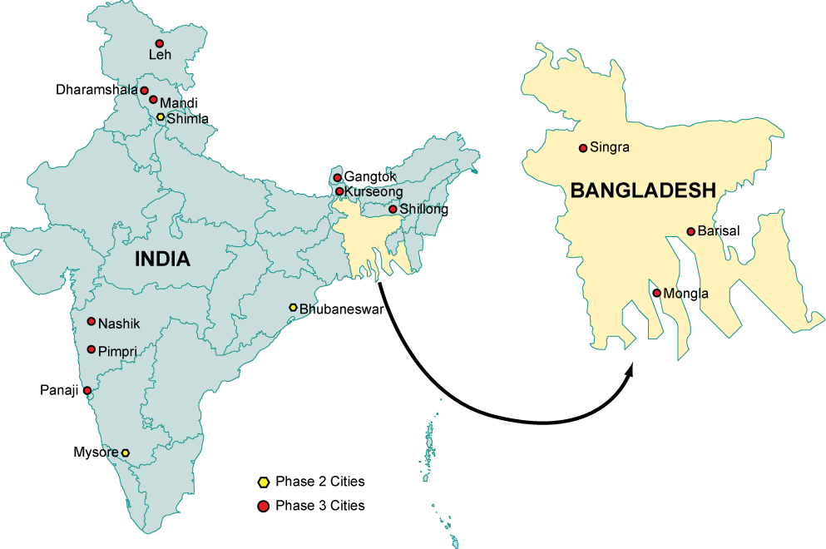

Building Urban Climate Resilience
Asian Cities Climate Change Resilience Network (ACCCRN)
Sponsored by Rockefeller Foundation
To implement the ICLEI – ACCCRN
process in approx 10 cities each
in India, Bangladesh, Philippines
and Indonesia
Support cities to develop Climate
Resilience Strategies
Help identify funding opportunities
for the implementation of the
climate resilience strategies
Networking and knowledge sharing
opportunities – regional &
international
Pilot Tested: Shimla, Bhubaneswar and Mysore
Cities: Leh, Dharamsala, Mandi, Gangtok, Kurseong,
Shillong, Nashik, Panaji, Nainital, Dehradun, Singra,
Mongla and Barisal

Slide 17
Building Urban Climate Resilience
Climate Change Adaptation Project Preparation and Financing in Urban India
Moving from ‘climate resilience strategies’ - ‘project preparation’ – ‘access to finance’
    Phase I: Prioritisation
    Phase II: Pre Feasibility Study (PFS)
Sponsored by ADAPT Asia Pacific
Partners: ADAPT Asia Pacific & CDIA
Duration : Feb 2014 to March 2015
Cities: Shimla, Bhubaneswar, Mysore
ICLEI ACCCRN Process:
Vulnerability Assessment and identification of resilience actions
Project Preparation:
Pre-feasibility studies preparation of detailed project reports
Financing:
Linkages to national schemes and other potential donors & defining appropriate mechanisms
ADB and USAID Adapt Asia -Pacific Program have agreed to fund the pre-feasibility study for “Integrated Drainage and Climate Change” project for Mysore city based on the City Resilience Strategy developed by ICLEI South Asia

Slide 18
Transformative Actions Program (TAP)
Mobilization of key actors
Visibilization of potential and needs
Raised Ambition & Accelerated Climate Action Implementation
The Compact of Mayors is the world’s largest cooperative effort among mayors and city officials to reduce greenhouse gas emissions, track progress, and prepare for the impacts of climate change
Local and subnational governments
Climate Action Reporting (Compact of Mayors, Carbonn, …)
Increased Access to Finance/Accelerated Climate Action Implementation
Development Agencies
Funding bodies and banks
TAP online platform
National governments (multi-level cooperation)
TAP Pavilion at COPs
TAP the potential of local and subnational climate action!
Notes:
The key purpose of the Action Program is mobilization of actors + visiblization of actions and potential, acceleration of finance and ambition
The Transformative Actions Program (TAP) aims to accelerate implementation of climate actions of local and subnational governments by scaling-up their direct investments and their increased engagement in national and global mechanisms focusing on capacity building, technology transfer and finance.

Slide 19
The 4 Action Pillars of the TAP
TAP Project Pipeline
Selection of 100 TAP frontrunner transformative local climate actions
TAP Platform
Online platform that offers visibility to the potential of local climate action by presenting all transformative actions in a structured, unified format
TAP Pavilion
Kick-off at COP21
TAP Advocacy for Accelerated Climate Action (TAACA)
Support in project proposal development
Basic information and communication facilitation platform for local/regional governments and funding bodies
Every year
At every future COP, the TAP will offer a physical space where TAP projects can present and exchange with other actors (national delegations, international donors, etc.)
sustained awareness-raising about the potential of local climate action, and its finance obstacles
With focus on: multi-level governance, effective vertical integration, new financing mechanisms
Mobilization of cities and regions
TAP the potential of local and subnational climate action!
Notes:
TAP project pipeline
A collection of up to 100 “TAP projects” that are selected every year, and presented at the annual UNFCCC Conference of Parties (COP), starting at the COP21 in Paris-Le Bourget from 30 November to 11 December 2015.
Cities and regions are invited to submit their Transformative Actions Program projects. These will be screened, with a limited number (maximum 100 projects) selected and given the official TAP approval, based on a number of criteria (proven feasibility, transformative potential, etc.) .
TAP Platform
An online platform to centralize projects and offer visibility as basic facilitation to financing institutions.
A platform for cities and regions to present their transformative actions in a structured, unified format to potential funders.
TAP Pavilion
The first Pavilion at the COP21 in Paris-Le Bourget will provide a physical space for exchange, with a selection of the first 100 proposed projects to national delegations, international donors and financing agencies, also from the private sector.
TAP Advocacy for Accelerated Climate Action (TAACA)
To help raise awareness of the potential of transformative, subnational climate action, in support of national climate action, through effective vertical integration.
This includes showcasing success stories, their wide range of benefits and interrelation to sustainable development.

Slide 20
Emani Kumar, ICLEI Deputy Secretary General and Regional Director-ICLEI South Asia Secreteriat
E-Mail: emani.kumar@iclei.org
Websites: www.iclei.org www.southasia.iclei.org
Thank You!

