Slide 1
Impacts of climate change on FOREST Ecosystems
22nd September 2015
New Delhi

Slide 2
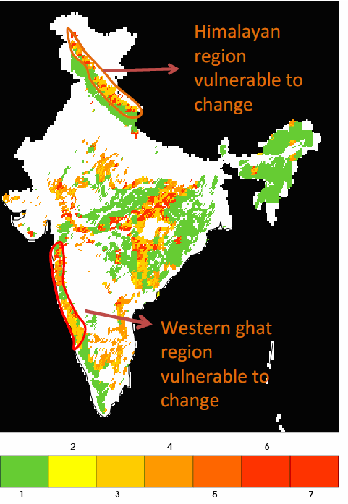
Climate change on Forests of India
The Himalayan forest eco-system are the most vulnerable to climate change
The coastal and Western Ghats regions (esp. the northern part of Western Ghats are more vulnerable) and others are moderately vulnerable to climate change
The north-east region is minimally projected to be impacted by climate change (as there are predictions of increase in rainfall)

Slide 3
Impacts on forests and communities
More than 50% of India’s forests will experience shift in forst types
adversely impact associated biodiversity and livelihoods based on forest products
40-70% of the forest grids likely to experience change resulting in forest die back and loss of diversity which can be irreversible.
Increased occurrences of fire, pest/diseases and invasive species
Changes in species assemblage/forest type and NPP
Forest dependent livelihoods may get severely affected, enhancing vulnerability of local communities.

Slide 4
Key principles to address impacts of CC on forests
Intricate linkages of forests with Food, Water, Energy and Livelihood security of local communities
Alongside afforestation, equal emphasis on restoring natural ecosystems like grassland and pastures, mangroves and other critical ecosystems ; as well as forests in urban/peri-urban landscapes.
Contribute in protection/enhancement of forests having relatively less dense forest cover.
Restoration of native bio-diverse species mix.
Local communities to play a key role in prioritizing range of ecosystem goods and services.
Empowerment of communities and strengthening of decentralized local governance of forests.

Slide 5
Adaptation practices to address climate change
Need to enhance ecosystem services like carbon sequestration and storage (in forests and other ecosystems)
Enhance biodiversity
Enhances provisioning services like supply of fuel, fodder, small timber, and NTFPs
Help adaptation of forest dependent local communities in the face of climatic variability

Slide 6
Win-Win Adaptation practices
Expand Protected Areas
Promote forest conservation, assisted natural regeneration and mixed species forestry
Promote species mix adapted to different temperature tolerance regimes
Develop and implement fire protection and management practices
Promote in situ and ex situ conservation of genetic diversity
Develop temperature, drought and pest resistance in commercial tree species
Develop and adopt sustainable forest management practices
Conserve forests and reduce forest fragmentation to enable species migration
Adoption of energy efficient fuelwood cooking devices to reduce pressure on forests.

Slide 7
Thank you

