Slide 1
Opportunities and Challenges of Smart Technologies
Jessica McDonald
Manager, International Programs
Edison Electric Institute
Civil Society Policy Forum, World Bank
11 October 2017

Slide 2

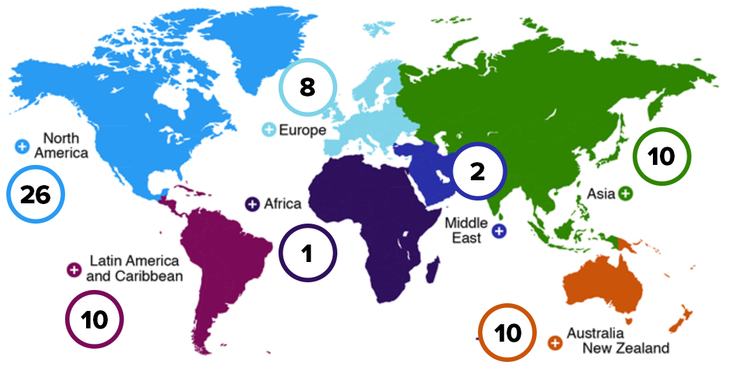
68 member companies operating across 90 countries

Slide 3

EEI International Programs provides members in the global electric power industry with a flexible platform for industry collaboration, dialogue, and thought leadership.
Dialogue
Outreach
Promotion
Analysis
C-Suite & CEO Meetings
Strategic Dialogues
Member Visits
Issue Working Groups / Task Forces
Webinars
Advisory Support
Conference & Event Participation
Academic Peer Reviews
International Edison Award
Innovation Case Books
Social Media Amplification
Webcasts
Global Trend Analysis
Research Articles
Industry Surveys
White Papers

Slide 4
Forces Shaping the Global
Energy Transition
Urbanization
Pace of Technological Change
Digitization
Smart Communities and Cities
Cyber Security
Resilience and Affordability

Slide 5
INNOVATION
Science
Regulation and Policy
Customer Services
Technology – Energy Infrastructure
Business Model

Slide 6
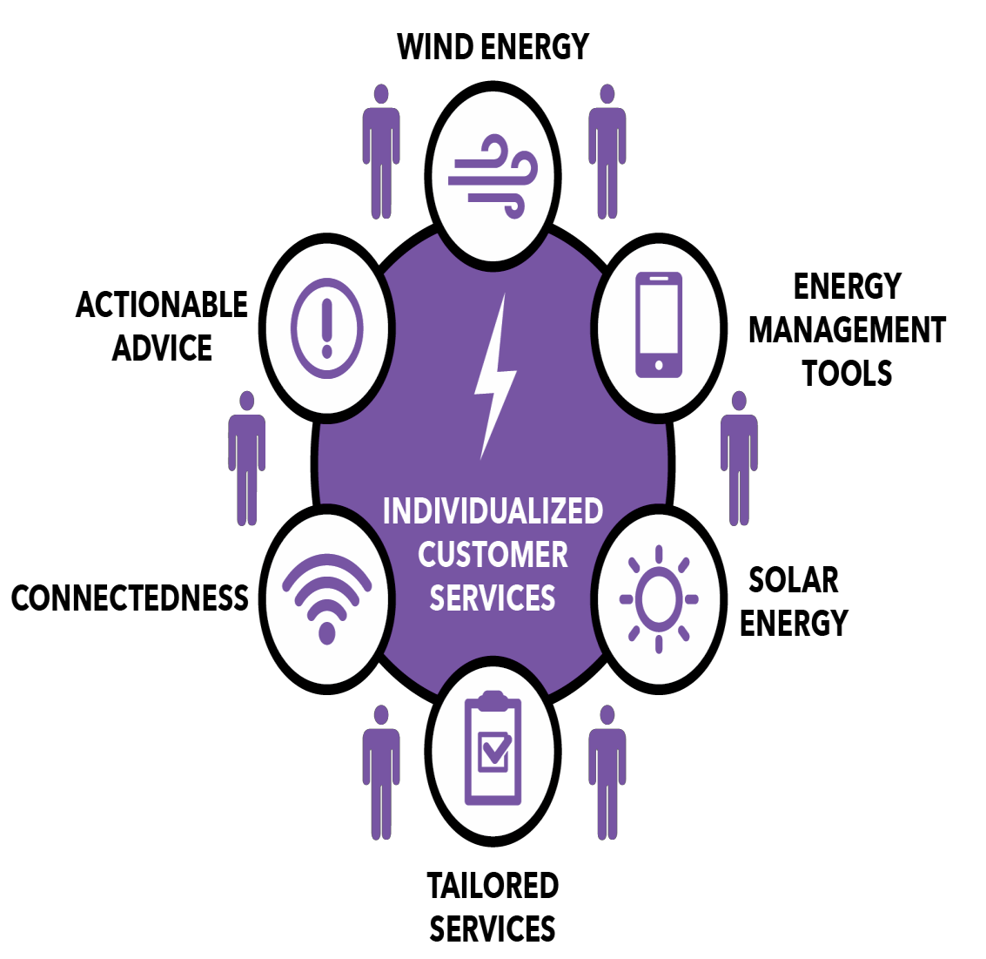
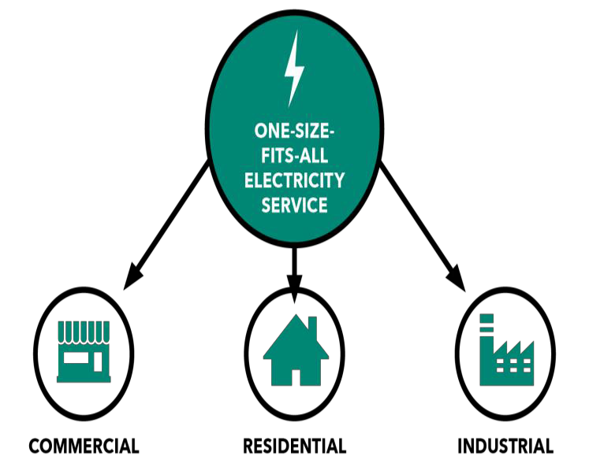

Individualized Customer Services
Choice, Control, Convenience, Cost
PRESENT
PAST
Source: The Edison Foundation Institute for Electric Innovation, Thought Leaders Speak Out: Key Trends Driving Change in the Electric Power Industry, December 2015
6

Slide 7
Technology Drivers
Technology Innovation – Smarter Infrastructure
Sensors – smart meters
Controls – demand response, apps
Artificial Intelligence - forecasting
Computational Science - algorithms
Peer-to-Peer transactions
Virtual and Augmented Reality
Smarter Infrastructure !
Sensing
Connectivity
Analytics

Slide 8
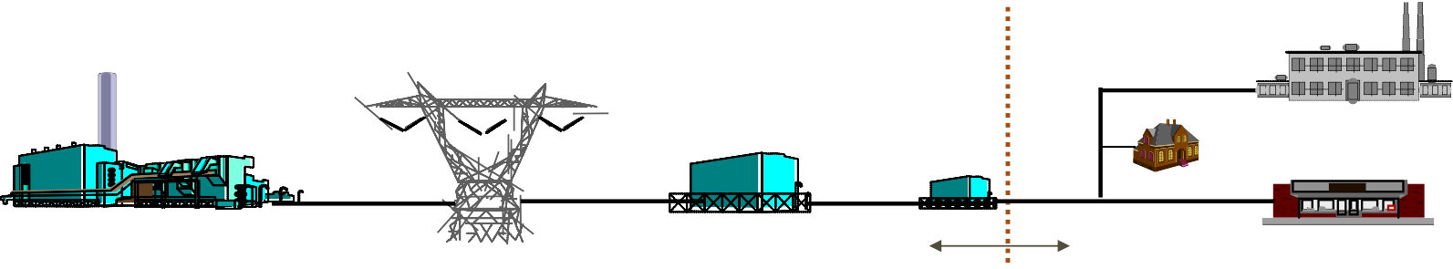
Energy Storage
Energy storage can be deployed in all parts of the
grid, has applications in all parts of the value chain.
Generation Transmission Distribution End User
C&I
Residential
Source: Navigant
Front of the Meter (FTM)
Behind the Meter (BTM)
Transmission Infrastructure Services
Distribution Infrastructure Services
Customer Energy Management Services
Bulk Energy Services
Ancillary Services
•Electric energy time-shifts (Arbitrage)
•Electric supply capacity
•Regulation
•Spinning, non- spinning and supplemental reserves
•Voltage support
•Black start
•Transmission upgrade deferral
•Transmission congestion relief
•Distribution
upgrade deferral
•Voltage support
•Power quality
•Power reliability
•Retail electric energy time-shift
•Demand charge management
FERC Regulated Matters |  | State Regulated T&D |  | End user
Source: Adapted from DOE/EPRI Handbook
8

Slide 9
Transition to Cleaner Energy is an Evolution

Slide 10
THANK YOU

