Slide 1


Cross Purposes:
After Paris, Multilateral Development Banks still funding billions in fossil fuels
Briefing prepared by Allison Lee & Alex Doukas,
Oil Change International

Slide 2
What do the Paris goals
mean for MDB finance?

Slide 3
Paris Agreement goals:
Links to fossil fuel finance
The Paris Agreement’s objectives include:
“Holding the increase in the global average temperature to well below 2°C above pre-industrial levels and pursuing efforts to limit the temperature increase to 1.5°C above pre-industrial levels [...]”
“Making finance flows consistent with a pathway towards low greenhouse gas emissions and climate-resilient development.”

Slide 4
Oil Change International analysis on post-Paris carbon budget:
The Sky’s Limit
Our approach:
Took IPCC carbon budgets and updated them to account for what we’ve burned in the last few years
Assessed the carbon budgets for a likely chance (66%) of staying below 2°C, and a medium chance (50%) of staying below 1.5°C
Used a proprietary industry database from Rystad Energy for oil and gas projects, and IEA data for coal mines, to determine emissions from already-developed fields and mines

Slide 5
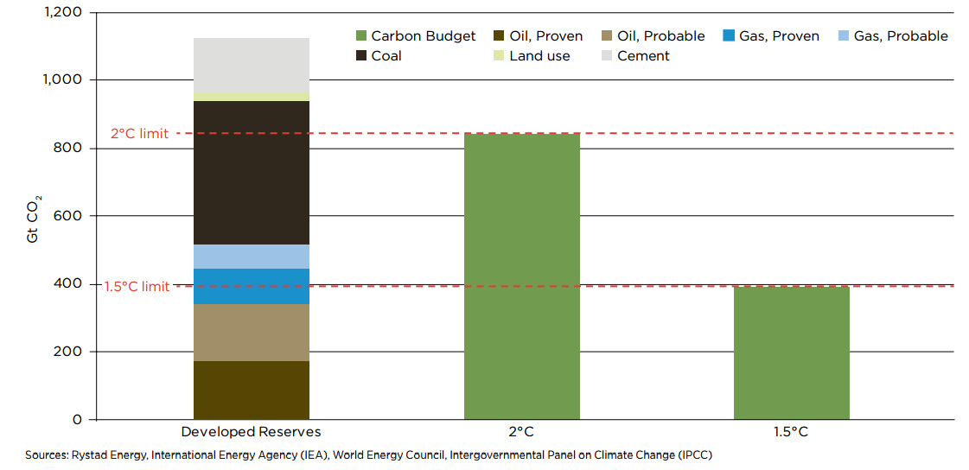
Emissions from developed fossil fuel reserves, plus projected land use & cement manufacture

Slide 6
...so what does this mean for
MDB energy finance...?

Slide 7
Context: Analyzing MDB finance
Our first briefing that contains data for FY16 across multiple MDBs (including first data for the post-Paris period)
Published under the umbrella of The Big Shift campaign (www.bigshiftglobal.org)
Being released in conjunction with complementary E3G briefing on MDB climate finance & energy finance performance
Release date: October 12. But today? Sneak preview

Slide 8
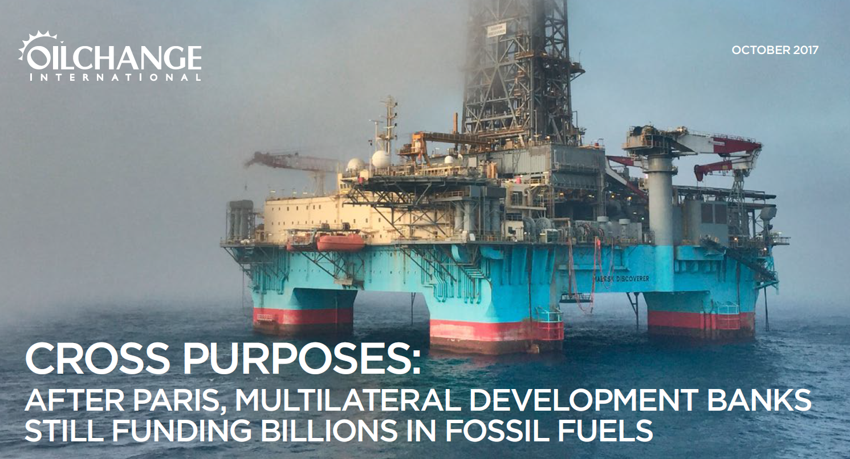

Slide 9
Some key findings from “Cross Purposes”:
In FY16, MDB fossil finance increased over FY15 in $ terms and as a % of MDB energy portfolios.
MDBs provided over $9 billion in public finance for fossil fuel projects in 2016 – with most approved after the Paris Agreement was reached.

Slide 10
Some key findings from “Cross Purposes”:
Oil & gas exploration-related finance doubled from FY15 to FY16, from roughly $1 billion to $2 billion.
This increase in fossil fuel exploration-related finance was led by the World Bank Group (WBG), Asian Development Bank (ADB), & European Bank for Reconstruction and Development (EBRD).

Slide 11
Some key findings from “Cross Purposes”:
Share of clean energy finance increasing, but energy finance categorized as ‘other’ still makes up plurality of MDB energy finance (incl. large hydro, most transmission & distribution, etc.)
WBG, EIB, & ADB were largest financiers of fossil fuels in 2016. WBG & ADB increased their fossil fuel finance from 2015 to 2016.

Slide 12
Key findings from “Cross Purposes” (cont’d):
To do their part in meeting global climate commitments, MDBs must end fossil fuel finance by 2020 – starting with finance for fossil fuel exploration and remaining coal finance – and rapidly shift energy finance toward clean energy.

Slide 13
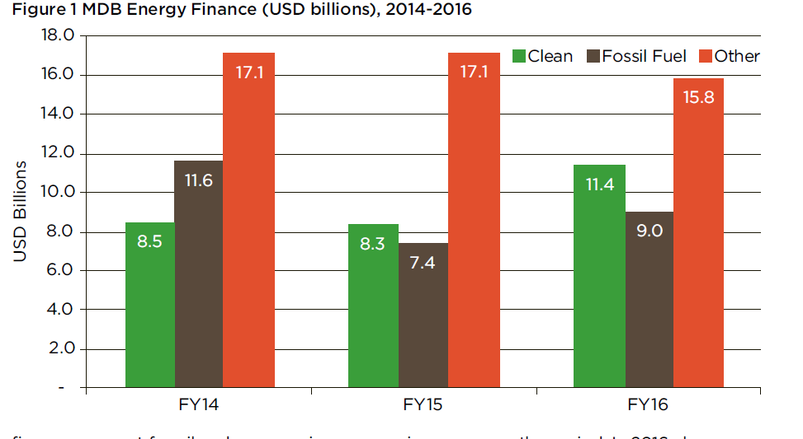
Methodology - what counts as “energy access”?
(continued)
Focus on provisions that make energy affordable for the poor e.g., effective, transparent safety nets to ensure that affordability of energy for basic needs, such as subsidies targeted at access instead of consumption;
Focus on productive uses in energy-poor communities, such as providing energy to smallholder farmers, small and medium enterprises and labor-intensive industries;
Involve grid extension to new periurban or rural areas (as opposed to simply feeding into the existing grid system);
Involve rural, off-grid solutions for providing energy services.

Slide 14
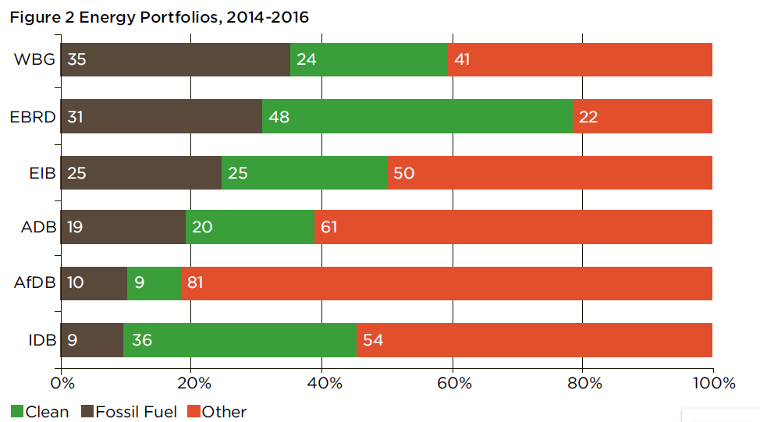
Methodology - what counts as “distributed renewable energy”?
Within energy access projects, we assessed whether a project involved any support for off-grid or mini-grid energy from renewable sources.
If a project’s funding was split between these forms and other forms of energy development, we tried to determine what portion of the funding was applied to off-grid or mini-grid clean energy and made an estimate.

Slide 15
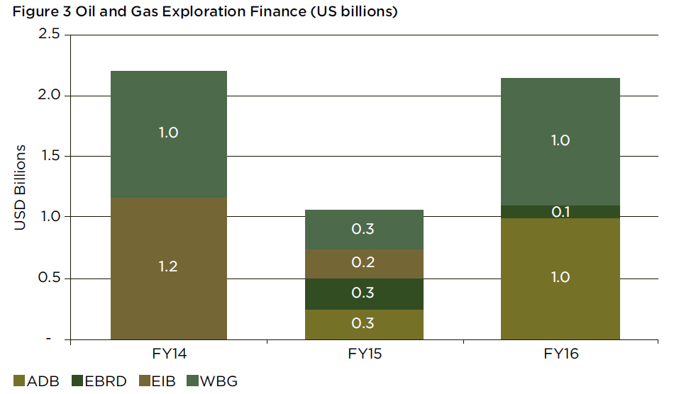
Key findings: The status quo is falling far short
None of the MDBs studied even came close to meeting benchmarks on energy access spending and distributed renewable energy finance (across the World Bank Group, Inter-American Development Bank, African Development Bank, and Asian Development Bank).
None of the MDBs invested more than 2% of their energy portfolios in off-grid or mini-grid solutions between FY12 and FY14.
Generally, fossil fuel projects at MDBs are not targeted at increasing energy access for the poor...

Slide 16
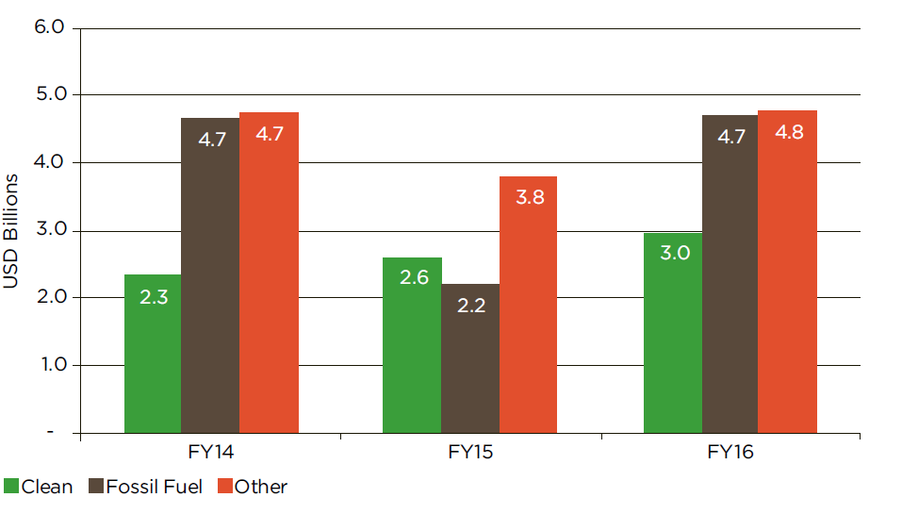
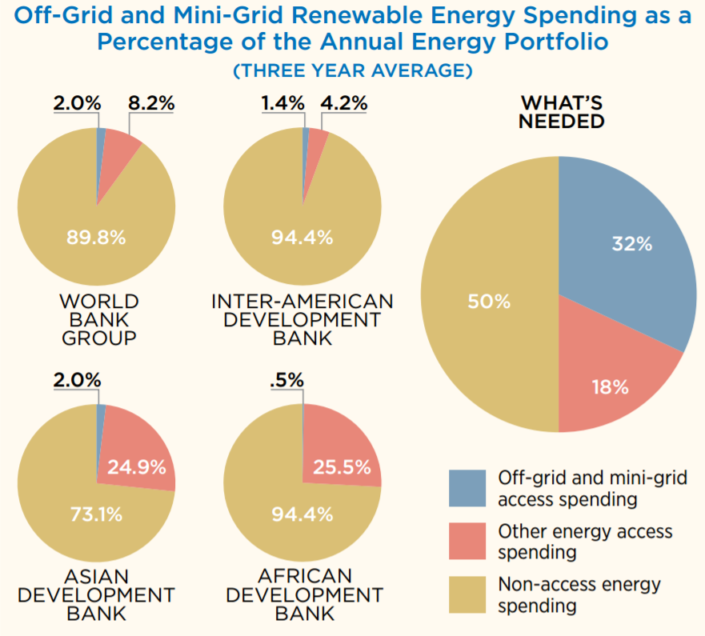

Slide 17
5 percent
That’s the proportion of MDB fossil fuel financing that was clearly linked to energy access objectives between FY12 and FY14
Fossil fuel projects at MDBs are not targeting increased energy access for the poor.

Slide 18

Contact
Alex Doukas
alex@priceofoil.org

Slide 19
Annex

Slide 20
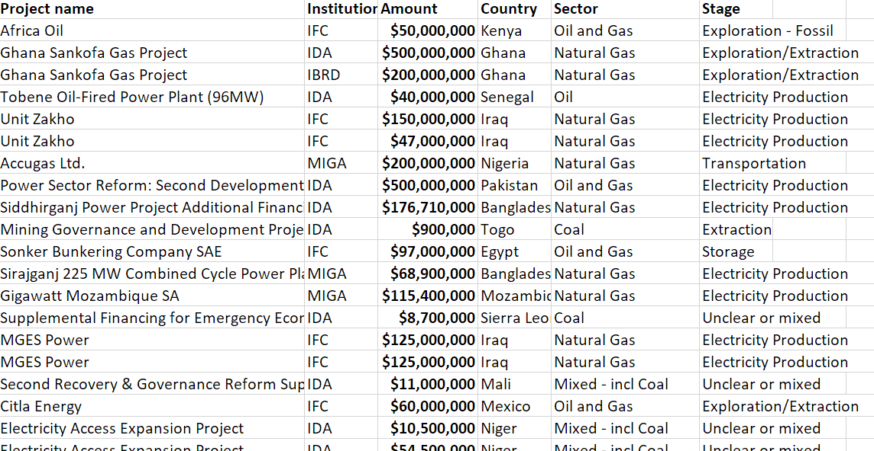
FY16 Fossil Fuel Projects

Slide 21
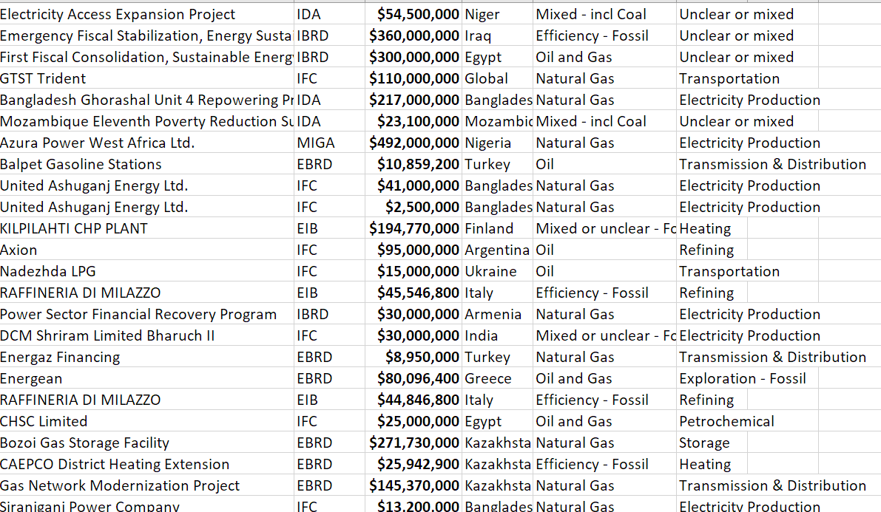

Slide 22
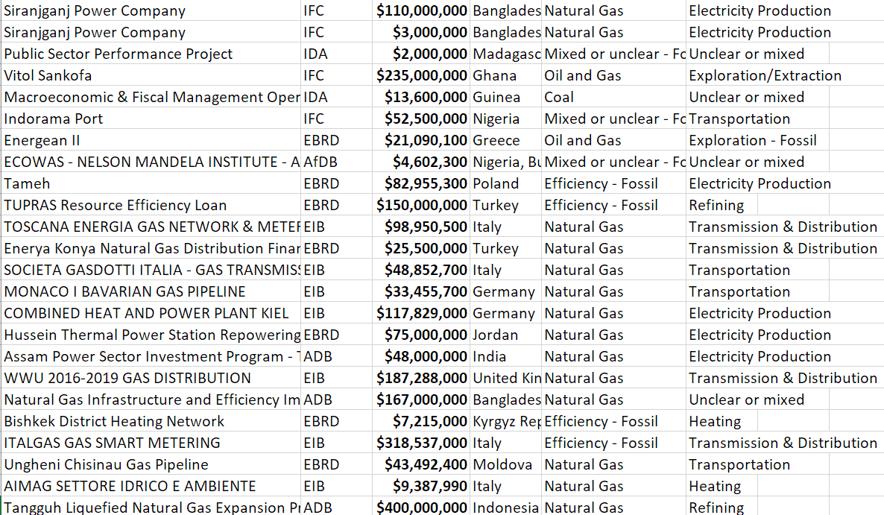

Slide 23
Does MDB energy finance support energy access goals?
Status and prospects

Slide 24
…so with off-grid and mini-grid solutions taking off,
are multilateral development banks keeping up?

Slide 25
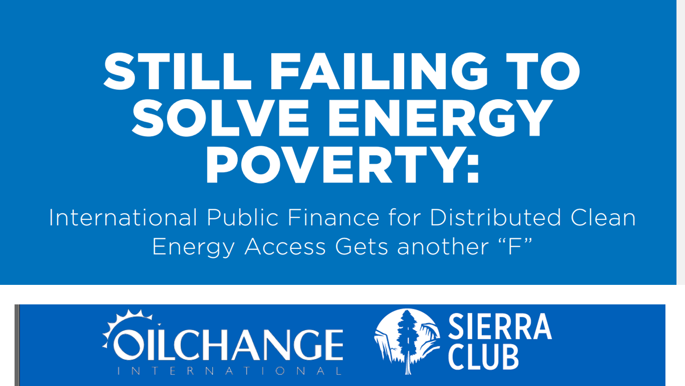

Slide 26
Oil Change International & Sierra Club report:
Still Failing to Solve Energy Poverty (2016)
Our approach:
Used Oil Change International database of thousands of public finance transactions. Analyzed FY2012-2014 energy transactions from African Development Bank, World Bank Group, Inter-American Development Bank, and Asian Development Bank.
Analysis considered (a) institution policies and programs, (b) whether projects were designed to support energy access, and (c) whether projects involved distributed renewable energy solutions.

Slide 27
Methodology - what counts as “energy access”?
Based on a review of project documents, a project must meet one or more of the following criteria:
Focus on a targeted number of new electricity connections or energy services, such as clean cookstoves (explicit mentions # of new connections / services provided);
Focus on electricity for services important to the poor, such as health clinics, schools, or telecommunications;
Aim to improve the reliability of electricity services in an area that largely serves poor households;

Slide 28
Methodology - what counts as “energy access”?
(continued)
Focus on provisions that make energy affordable for the poor e.g., effective, transparent safety nets to ensure that affordability of energy for basic needs, such as subsidies targeted at access instead of consumption;
Focus on productive uses in energy-poor communities, such as providing energy to smallholder farmers, small and medium enterprises and labor-intensive industries;
Involve grid extension to new periurban or rural areas (as opposed to simply feeding into the existing grid system);
Involve rural, off-grid solutions for providing energy services.

Slide 29
Methodology - what counts as “distributed renewable energy”?
Within energy access projects, we assessed whether a project involved any support for off-grid or mini-grid energy from renewable sources.
If a project’s funding was split between these forms and other forms of energy development, we tried to determine what portion of the funding was applied to off-grid or mini-grid clean energy and made an estimate.

Slide 30
Key findings: The status quo is falling far short
None of the MDBs studied even came close to meeting benchmarks on energy access spending and distributed renewable energy finance (across the World Bank Group, Inter-American Development Bank, African Development Bank, and Asian Development Bank).
None of the MDBs invested more than 2% of their energy portfolios in off-grid or mini-grid solutions between FY12 and FY14.
Generally, fossil fuel projects at MDBs are not targeted at increasing energy access for the poor...

Slide 32
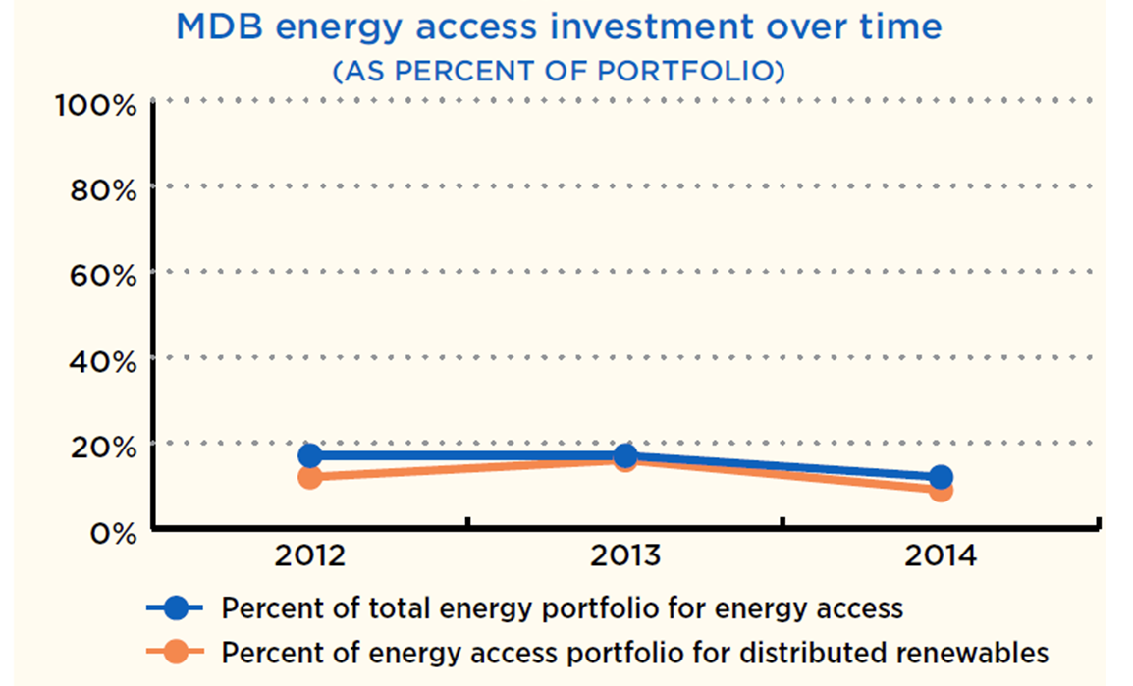

Slide 33
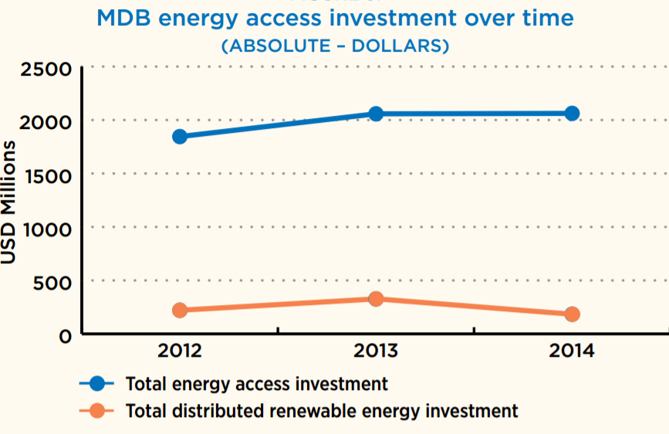

Slide 34
AfDB has been a leader in some areas, but lagging in others
Among the MDBs, AfDB has the highest % of projects focused on energy access - but the lowest % for distributed renewable energy

Slide 35
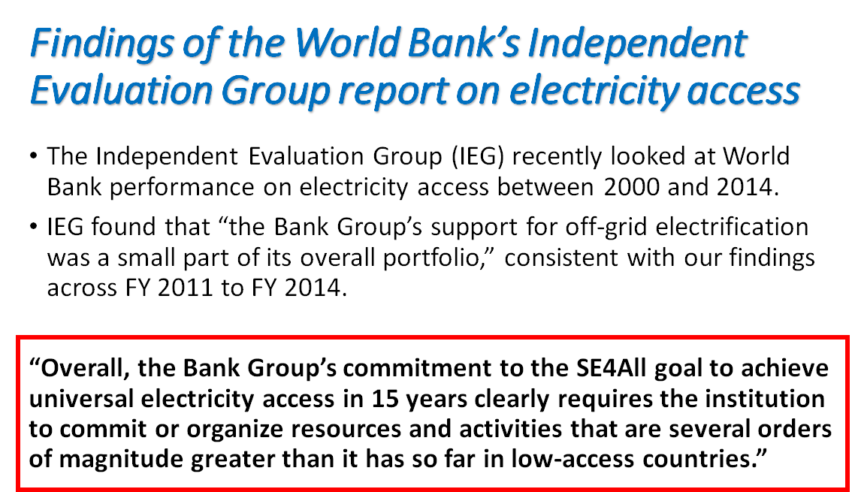

Slide 36
5 percent
That’s the proportion of MDB fossil fuel financing that was clearly linked to energy access objectives between FY12 and FY14
Fossil fuel projects at MDBs are not targeting increased energy access for the poor.

