Slide 1

Delivering a decent standard of living without costing the earth

Slide 2
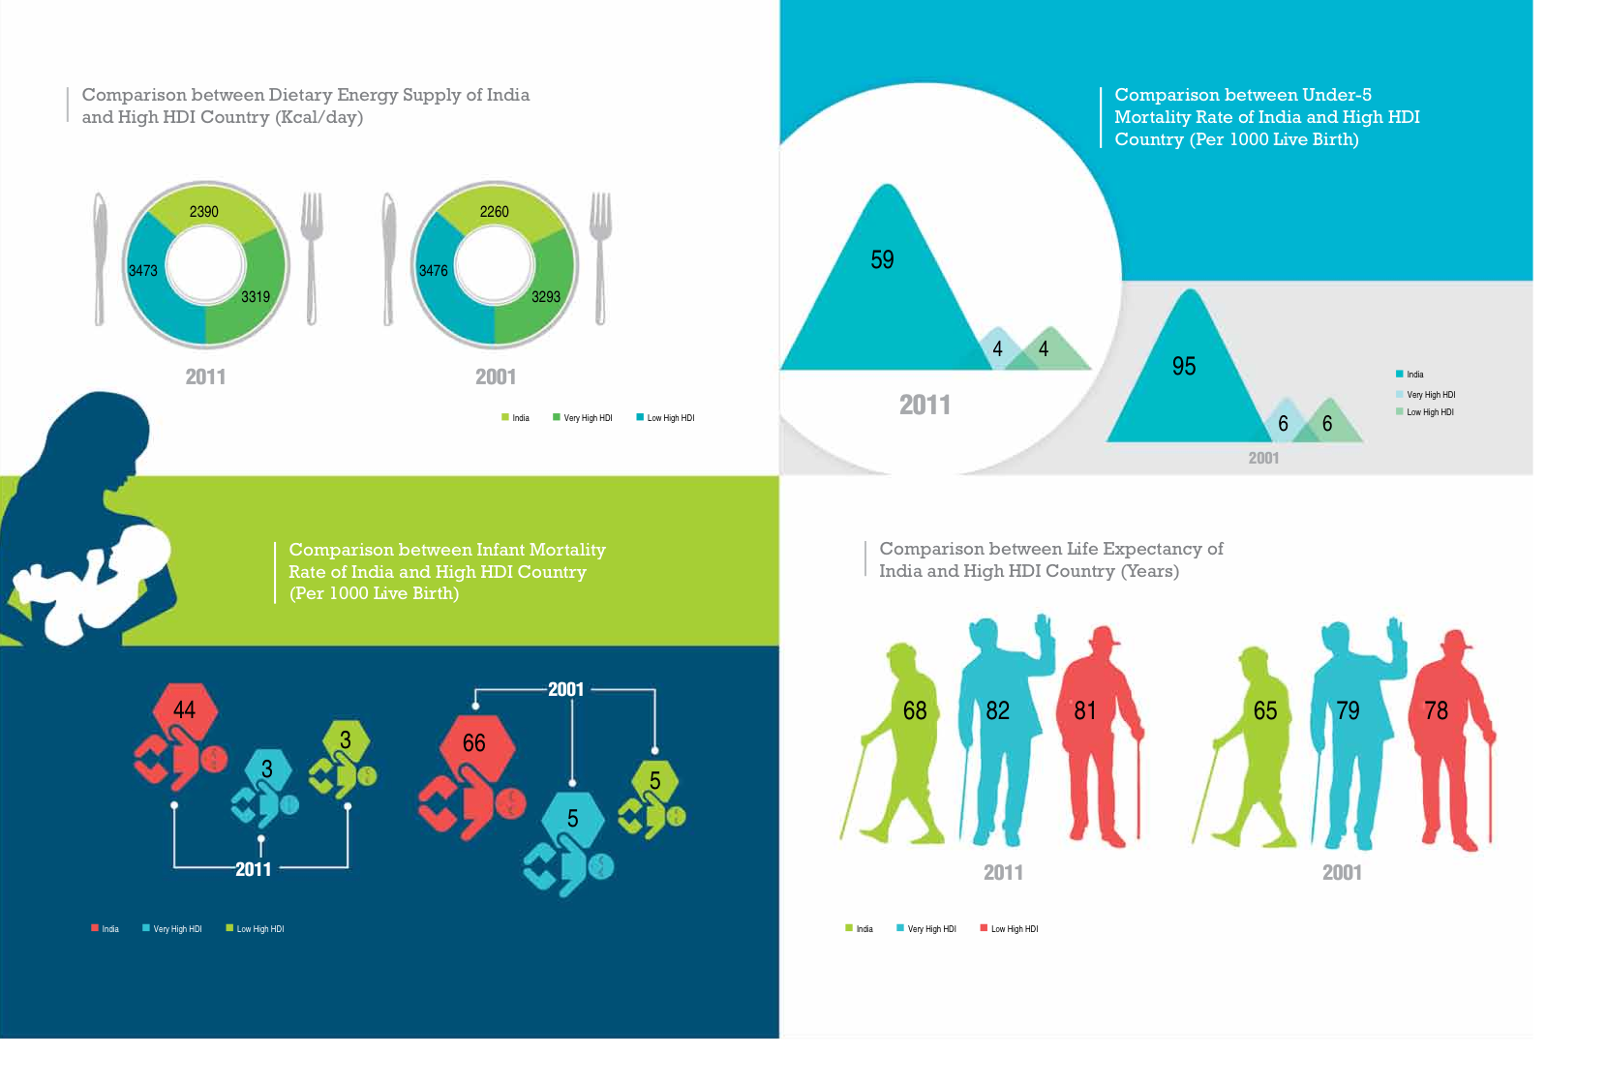
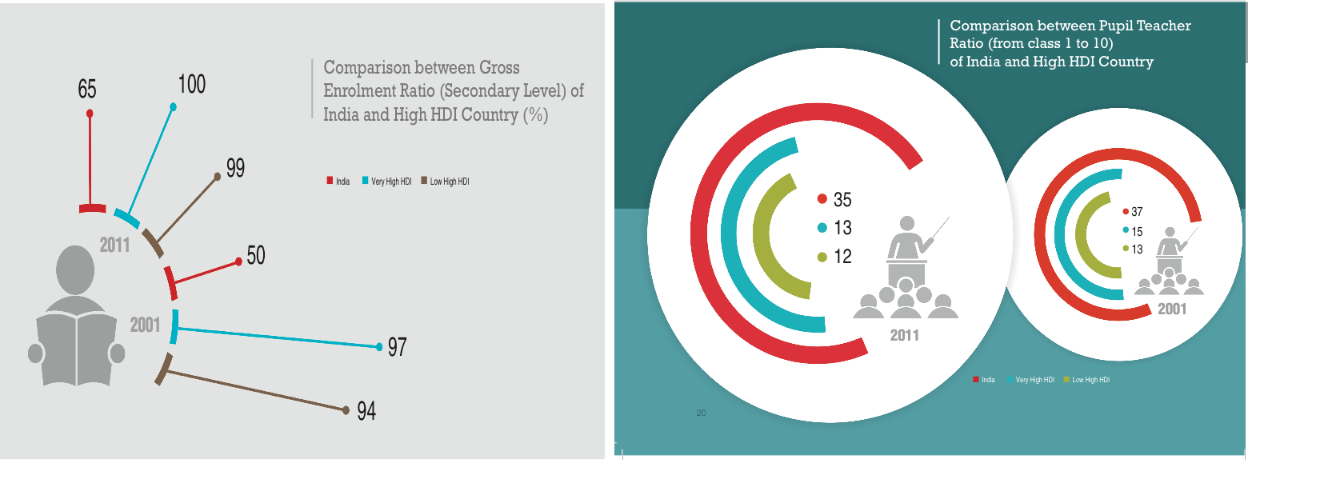
Development Deficit in India
India aspires to reach a Human Development Index threshold of 0.9.
Currently it is about 0.6 ranking about 135.
Going beyond the indicators of the Human Development Index, India’s continue to rank very low when compared to the development levels of countries with high Human Development Index for various indicators.
Health Indicators:
Indicators related to Access to Education

Slide 3
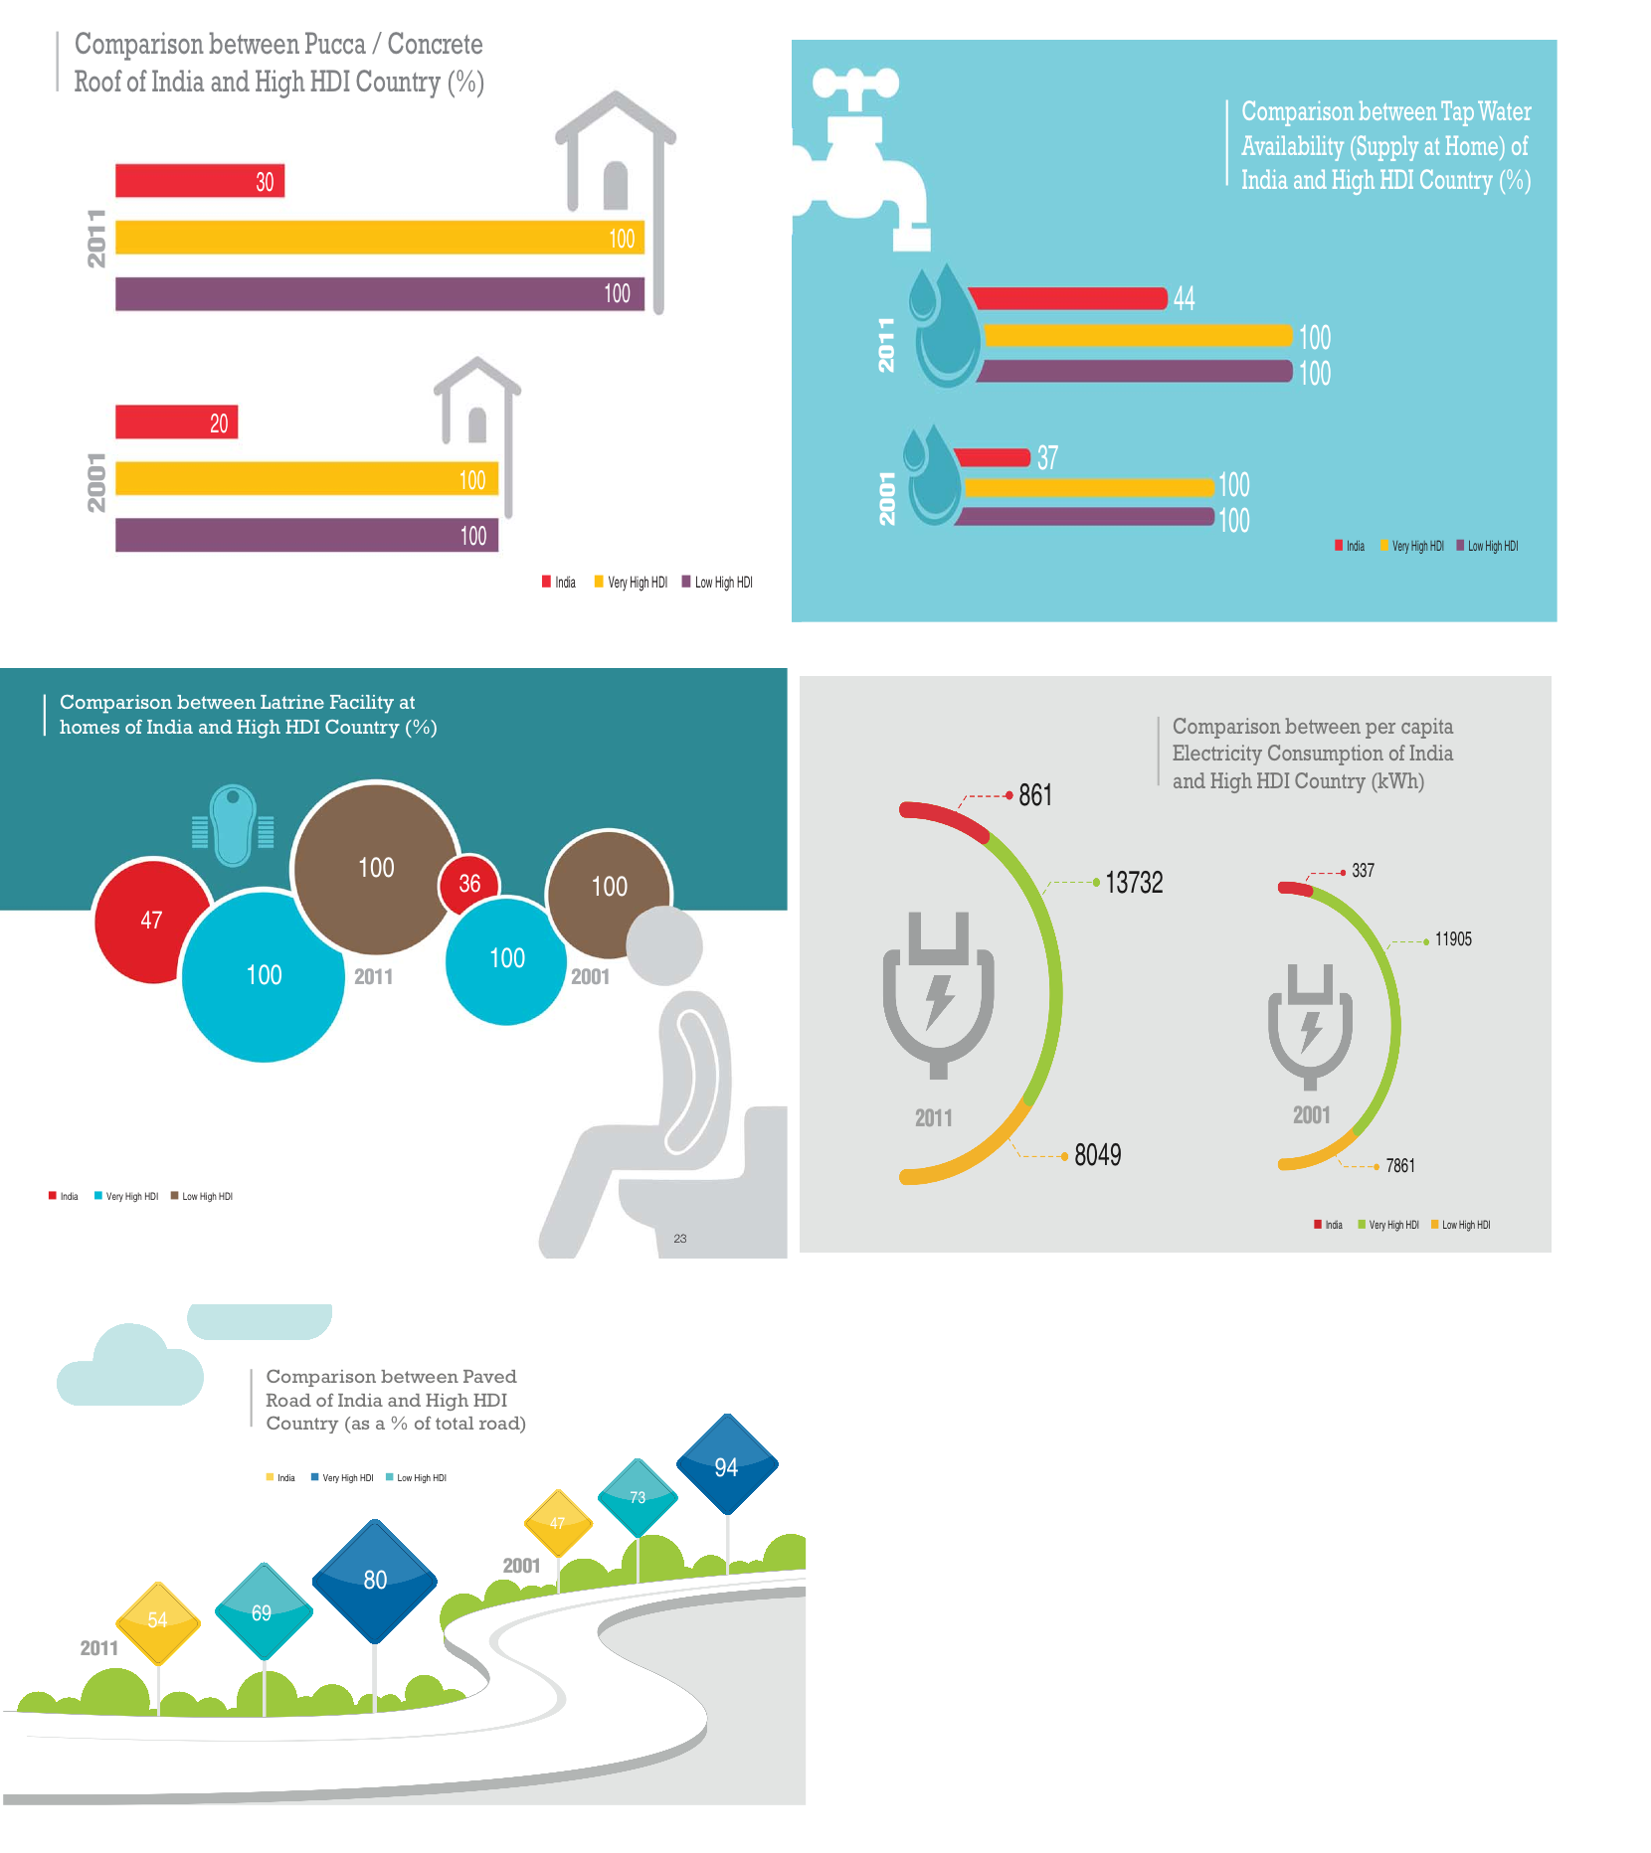
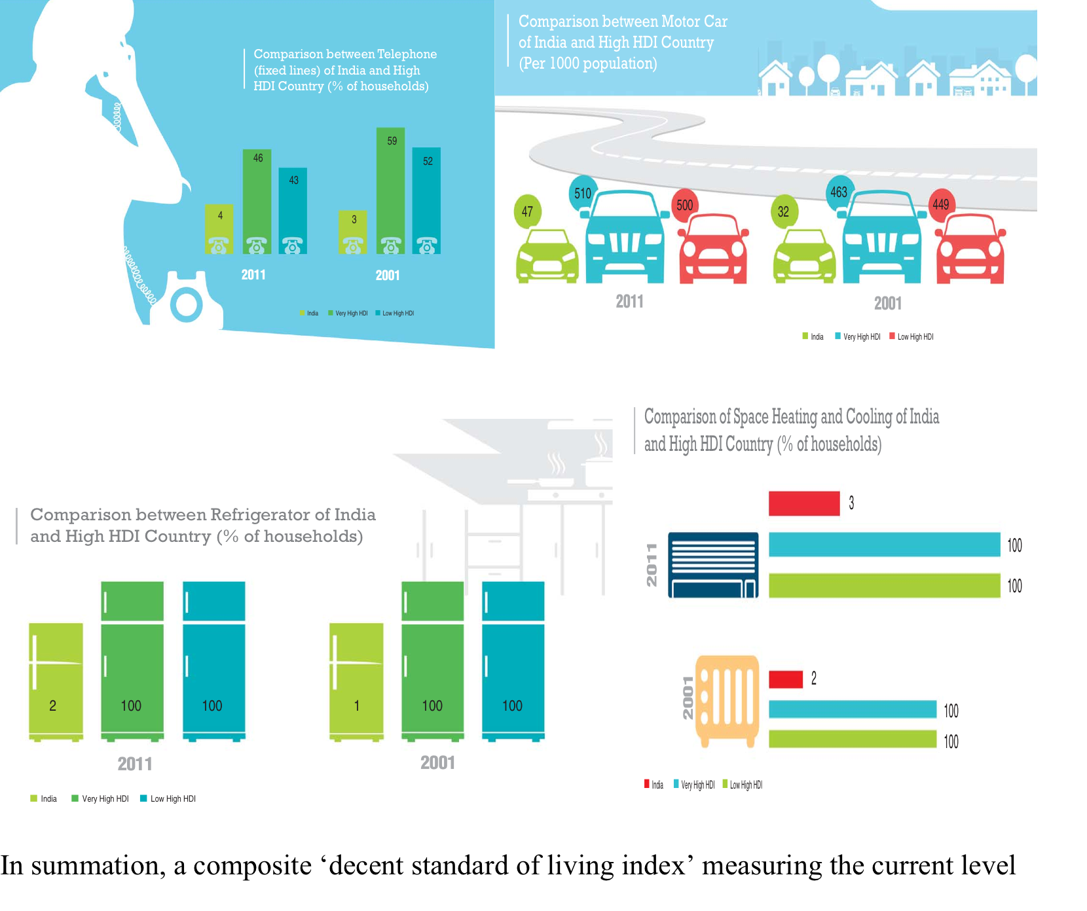
Development Deficit
Indicators related to Access to Basic Infrastructure
Prosperity Indicators

Slide 4
Development Deficit - Short
If past trends of growth and development continues, it could take India as much as 30 years to reach the thresholds of development of Countries with High Human Development Index

Slide 5
The Driver for Achieving Decent Standard of Living
India needs to opt for polices and programmes that could accelerate addressing poverty elimination
One of such key drivers clearly is energy access
enough evidence to prove that, without energy services of adequate quality and quantity, countries have struggled to meet their Millennium Development Goals (MDGs)
Clear co-relation between energy access and HDI and energy access and GDP
Clear co-relation between energy access and the 16 sustainable development goals and indicators

Slide 6
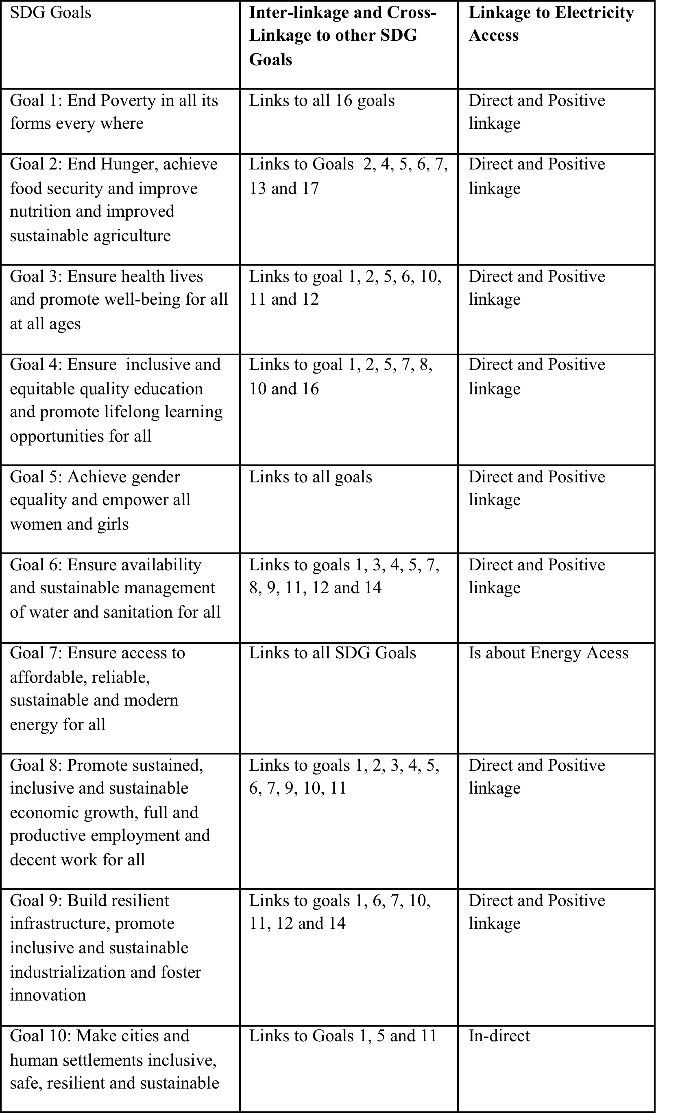
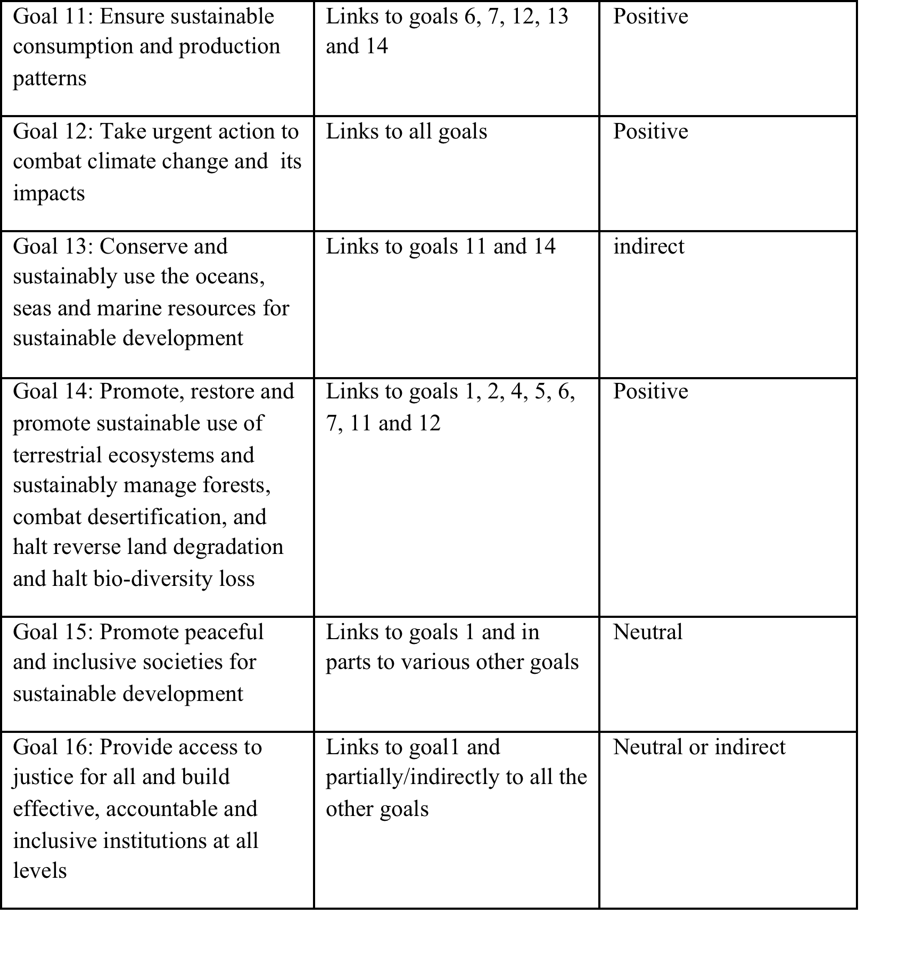

Slide 7
The Solution
Hitherto followed policies have not worked.
Further, the IEA predicts that with a continued dependence on business as usual plan, 20 % of India’s population will continue to be denied access to electricity even in the year 2030.
Therefore what is required is a energy access solution that
Ensure lighting, heating and cooling and cooking needs
Ensures adequate availability of energy for productive use – livelihood enhancement
Ensures basic infrastructure facilities like health, education, water and sanitation
Access to markets
is scalable and replicable
is cost effective and could be made cost effective
is reliable and not prone to “last mile connectivity” issues
Is designed to meet with variable electricity and energy needs of people and co-exists with grid in the medium and long term

Slide 8
DRE- A Cost Effective Solution?

Slide 9
Delivering a decent standard of living without costing the earth! – India’s iNDC for 2030 – could it be a milestone
400 Million People provided with energy access through DRE Mini-Grids by 2022
200 GW of Renewable Energy by 2022
Stand alone clean energy solutions for the 80% of India’s households that still depend on traditional bio-mass for heating and cooking

