Slide 1
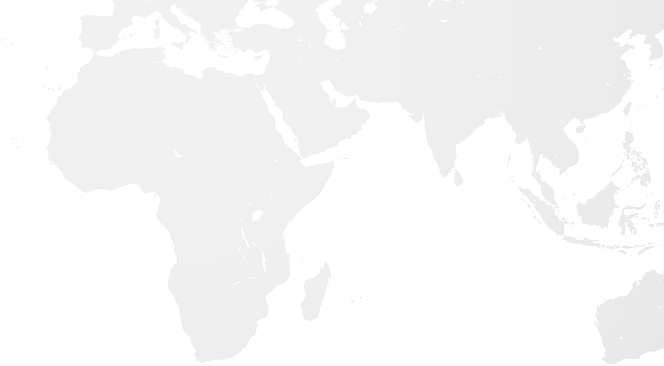
Enhancing Mitigation Ambition
India and Africa
11th October 2017
World Bank Annual Meeting
Washington D.C.
Samiksha Dhingra

Slide 2

Genesis of the Platform
The formation of the GHG Platform India was a culmination of a process that began with preliminary discussions amongst some partner organisations at the sidelines of the Lima Conference of Parties (COP) of the UNFCCC in December 2014.
It was in Peru, that the findings from a similar Platform in Brazil, the System for Estimation of Emissions of GHG (SEEG), was presented at a side event.
Following on, and to explore the merits of establishing a similar Platform in India, a one-day technical workshop was held in New Delhi in April 2015 that included participation of four Brazilian experts involved with the inception of SEEG.
In order to support the process in India, the SEEG Platform also agreed to share their methodologies and templates and provide technical assistance to the project partners.

Slide 3
Rationale for the Platform
Starting point to track GHG emissions
Understanding development trends
To identify opportunities for establishing climate goals and showcase India's actions on climate change
To address gaps in GHG data availability at the national and state levels
To enhance accessibility to data
To help inform policy dialogue and decision making
Need of a database that can be accessed by all

Slide 4
What are we trying to accomplish?
Quantificationn is neither over nor under actual emissions. Uncertainties are removed as far as practicable.
Consistent methodologies allows meaningful comparison of emissions over time.
Ensuring GHG emission estimates reflects the actual GHG emissions of national and/or state boundary
A
Accuracy
C
Consistency
R
Relevance
T
Transparency
C
Completeness
Disclosure of all assumptions and clarity on methodologies and data sources used.
Account for and report on all GHG emissions within boundary. Justify any specific exclusions.

Slide 5
www.ghgplatform-india.org

Slide 6

About the Platform
Follows IPCC guidelines (2006)
Clearly defines methods, assumptions and limitations
Uses official and publicly sourced data
Provides insights and trends of key activities leading to emissions
Informs policy evaluation and decision making
Independent estimation of India’s GHG emissions for 2005-13
Notes:
Independent Estimation of India’s GHG emissions for 2005-13
Follows IPCC 2006 revised guidelines
Clearly defines uncertainty, assumption, relevance, recalculation, QA/QC
Uses officially and publicly sourced data
Provides insights and trends of key activities leading to GHG emissions
Informs policy evaluation and decision making

Slide 7
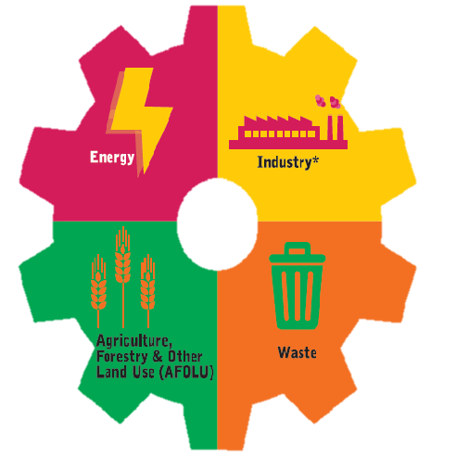
Key Outputs of the Platform
Annual estimates of green house gases at national and state level for India
to
2005
2013
From the following sectors

Slide 8
All emissions in Million tCO₂e
Notes:
Emissions grew by almost 900 Mt.
Emissions from Energy, IPPU sector have increased but they have decreased from AFOLU sector
Reduced deforestation
Reduced Livestock Population

Slide 9
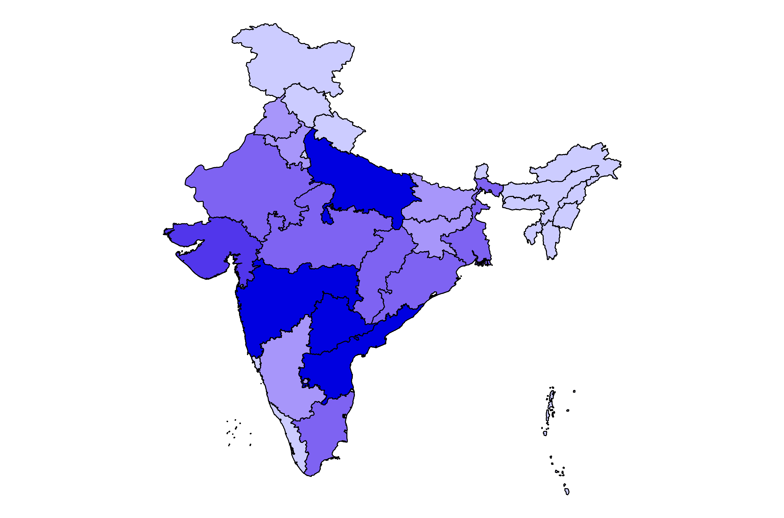
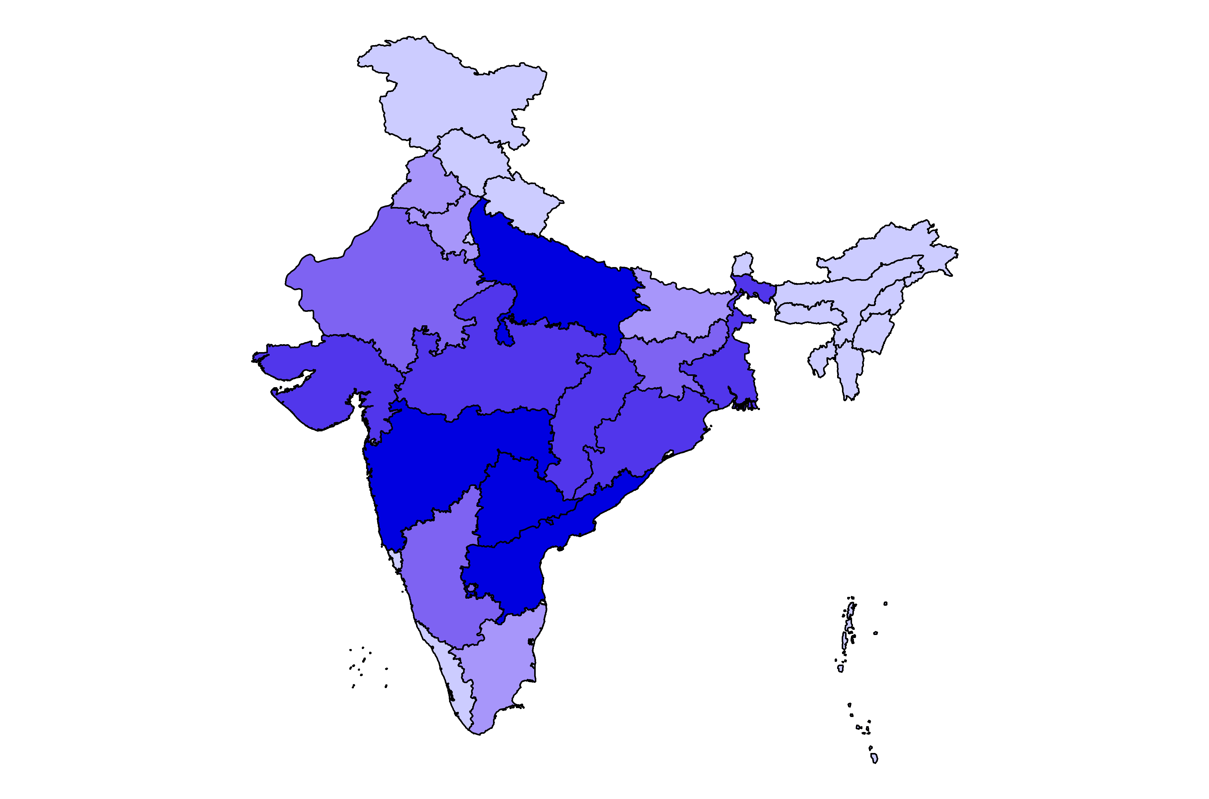
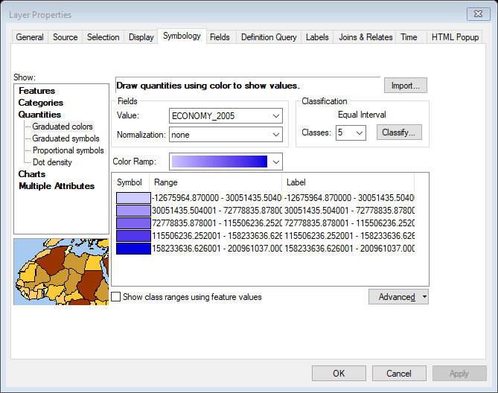
India’s Emission Profile in 2005
India’s Emission Profile in 2013
Emissions
(Million tCO2e- AR2 GWP)
Emissions
(Million tCO2e- AR2 GWP)
200.97
271.67
-12.68
-12.63
Notes:
Emissions increased from Madhya Pradesh, Chhatisgarh, Jharkhand, Orissa. This is mainly due to increase in industrial activities in these states. Emissions from Tamil Nadu decreased in year 2013.

Slide 10
Top 10 States in 2005

Slide 11
Top 10 States in 2013
Notes:
Jharkhand replaces Madhya Pradesh and Tamil Nadu is no longer in top 10

Slide 12
Source: WRI CAIT Climate Data Explorer
Notes:
Linear trend.
Land Use Emissions decreasing from 2005 to 2013
Energy emissions have increased. Agriculture emissions are also increasing at a linear rate.

Slide 14
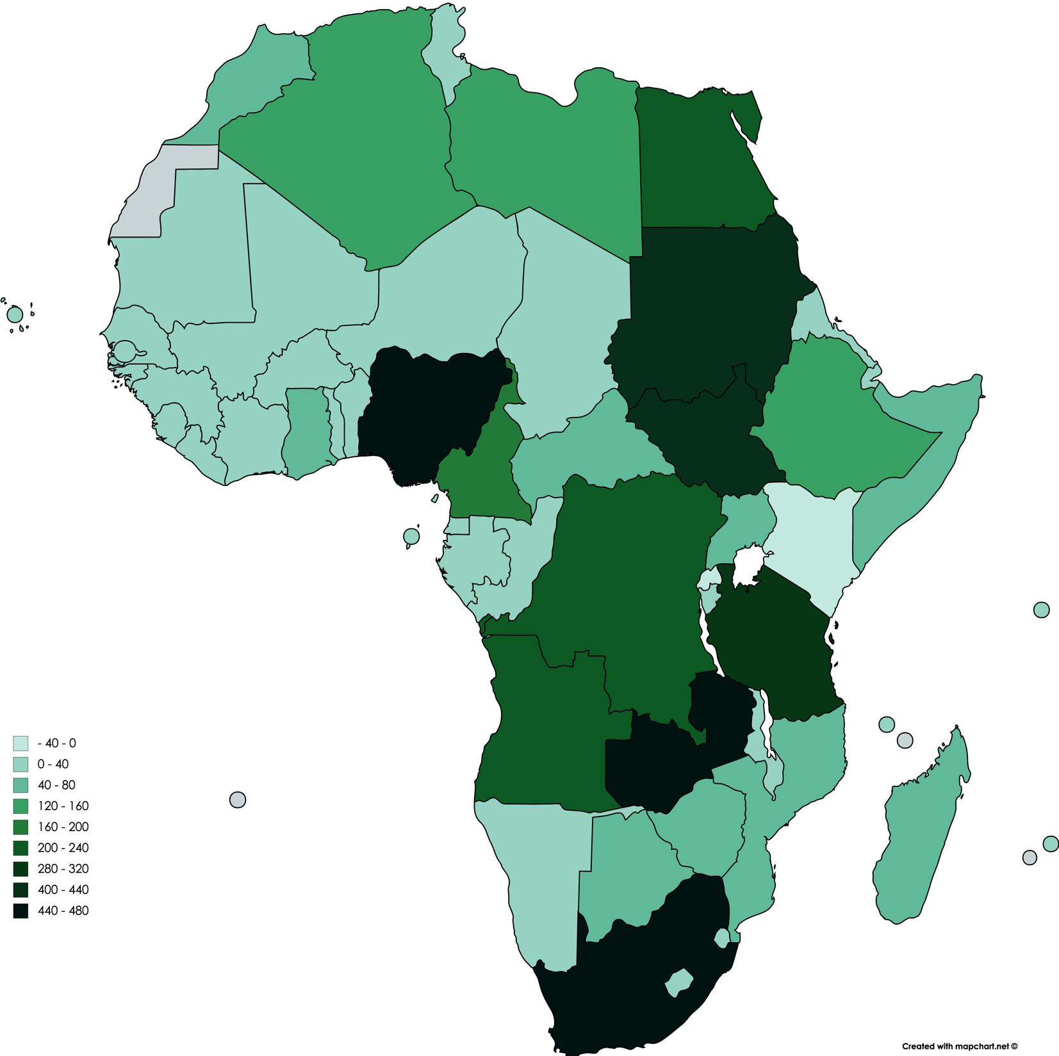
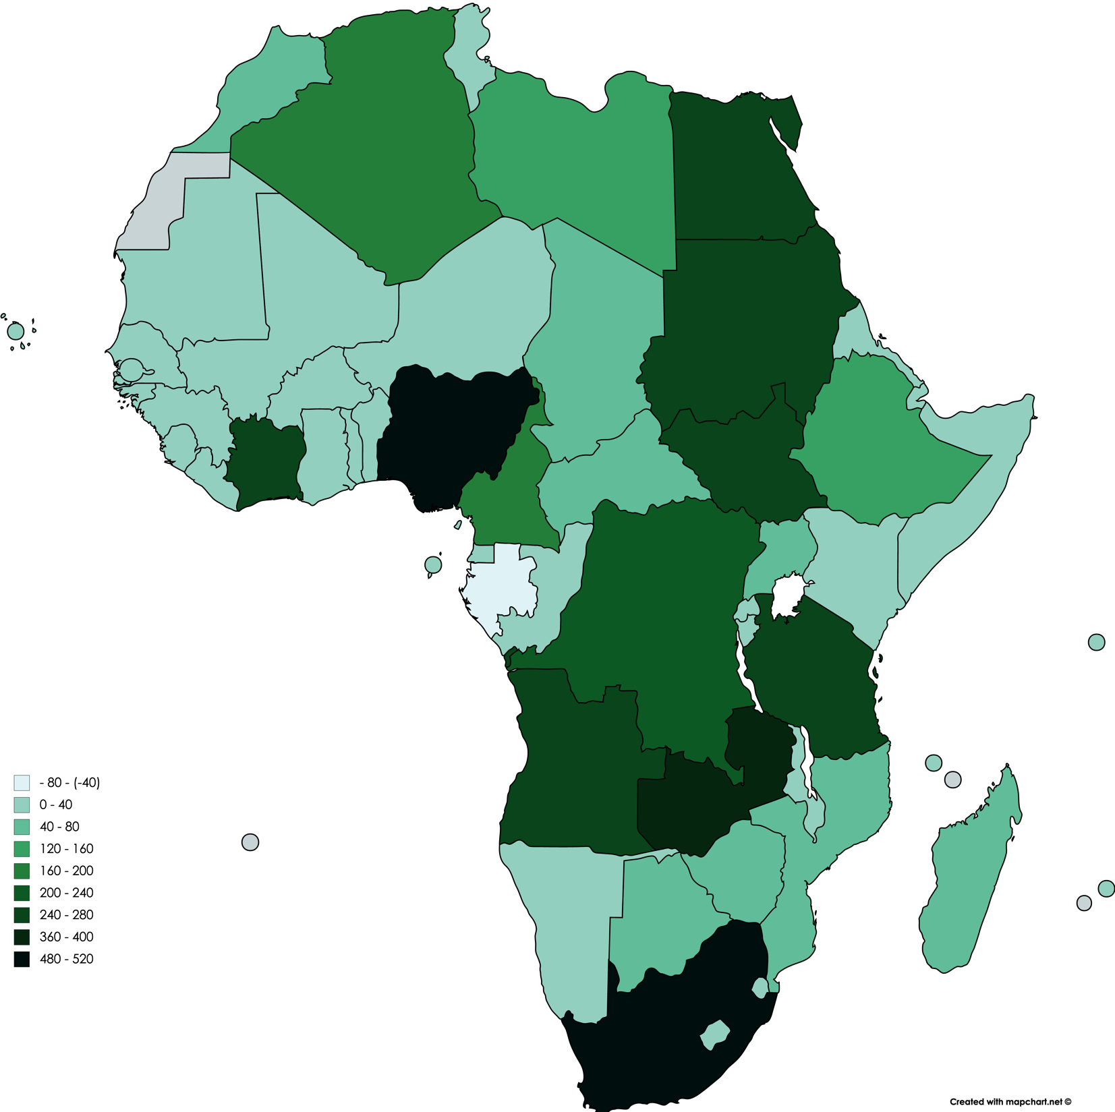
Africa’s Emission Profile in 2005
Africa’s Emission Profile in 2013
Source: WRI CAIT Climate Data Explorer
Map created using MAP CHART (https://mapchart.net/africa.html )
Notes:
South Africa, Nigeria and Zambia are the top emitters from Africa both in 2005 and 2013.
Emissions from Tanzania and Sudan dropped in the year 2013.
Gabon’s emissions decreased from 2005 to 2013 and it is to be noted that the country has now negative emissions.
Rwanda and Kenya had negative emissions in 2005 but in 2013, both the countries are net emitter of CO2.

Slide 15
Source: WRI CAIT Climate Data Explorer

Slide 16
Change in Sectoral GHG emissions from India and Africa
Energy – 2.41%
Energy – 6.80%
Industry –
4.29%
Industry –
5.51%
AFOLU – 1.31%
AFOLU – 1.95%
Waste – 1.95%
Waste – 3.90%
Africa
India
Source: Vasudha Foundation Analysis
using WRI CAIT Climate Data Explorer
Source: GHG Platform India
Notes:
India’s overall emissions grew at a CAGR of 5.71% from 2005 – 13. Emissions from AFRICA grew at a CAGR of 0.3%
These trends give us an idea for mitogation opportunities. We know where we need to put in more effort

Slide 17
Mitigation Opportunities for Emission Reduction
Energy
efficiency; fuel switching; Renewable (hydropower, solar, wind, geothermal and bioenergy); CO2 Capture and Storage (CCS)
More fuel efficient vehicles; hybrid vehicles; biofuels; modal shifts from road transport to rail and public transport systems; cycling, walking; land-use planning
Transport
Industry
More efficient electrical equipment; heat and power recovery; material recycling; control of non-CO₂ gas emissions
Notes:
Changes in lifestyle and behaviour patterns can contribute to climate change mitigation

Slide 18
Mitigation Opportunities for Emission Reduction
Agriculture
Better technology, Renewables, Capacity Building, Dietary Manipulation, Green Feed and Fodder, Strategic feed supplementation, Cropland Management, Rice Management
Reforestation, Afforestation, Restoration of degraded lands, Restoration of cultivated organic land, Grazing Land Management
Forestry
Waste
Regulatory standards for waste treatment and management, Market incentives for improved waste management and recovery of methane

Slide 19
Thank you!

